Slide 1
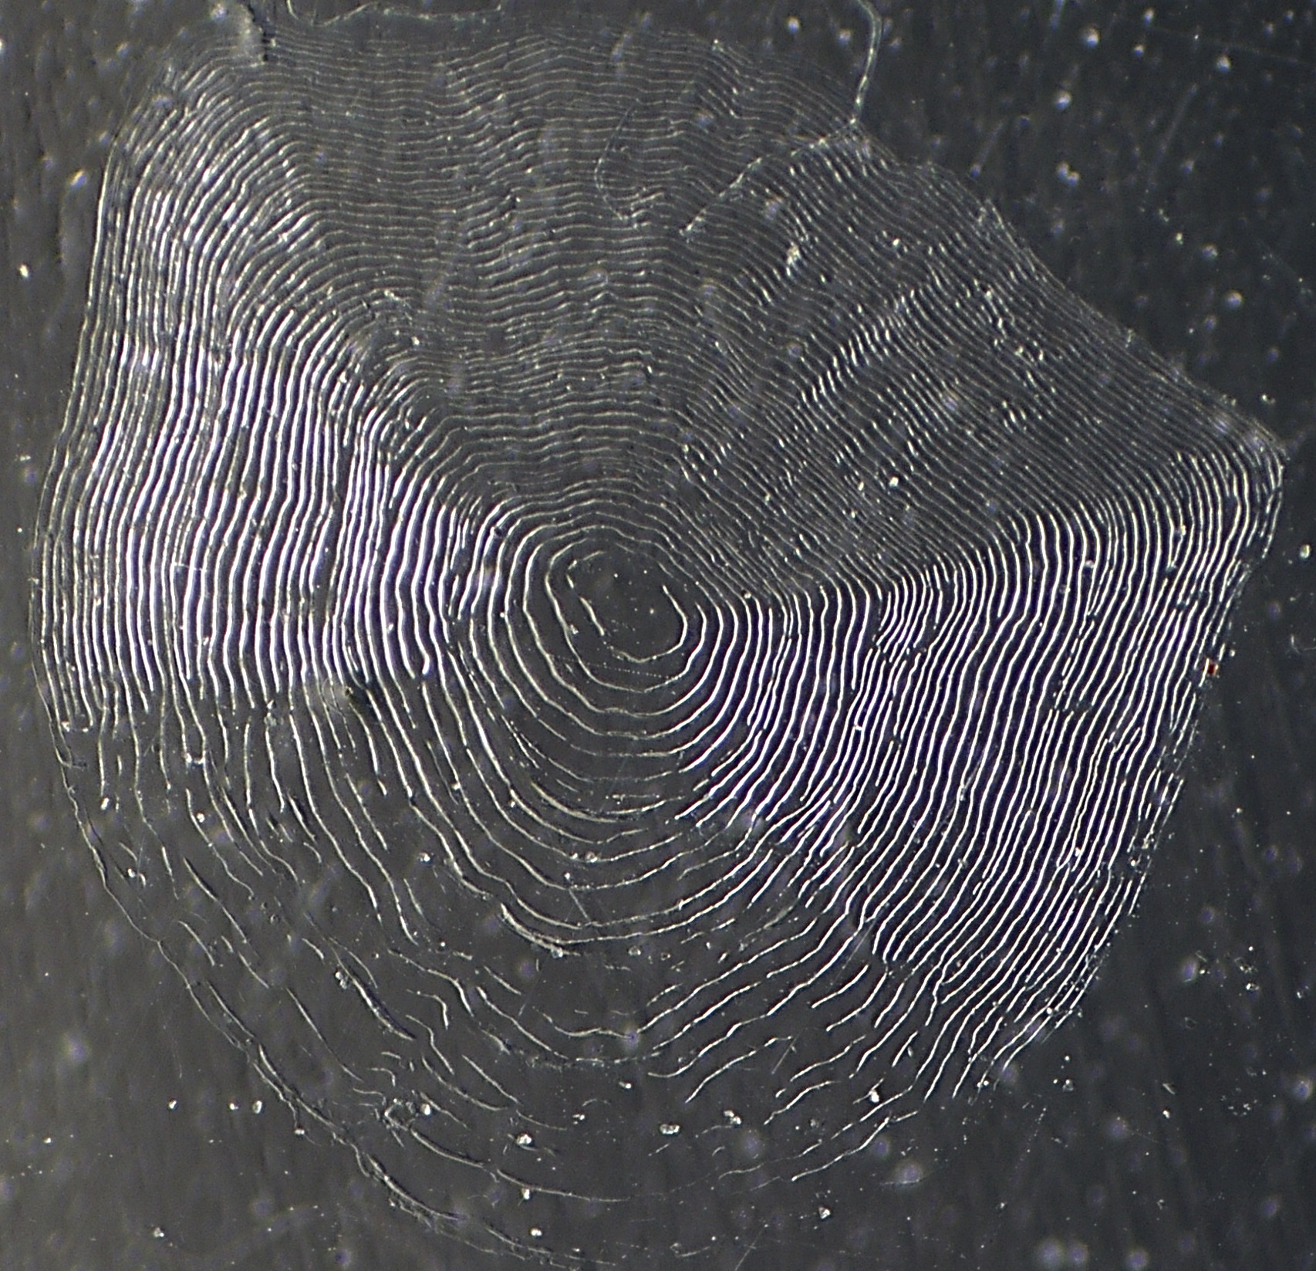
223 mm Kiyi
Notes:
223 mm Kiyi … age 6?

Slide 2
187 mm Kiyi
Notes:
187 mm Kiyi – Age 5

Slide 3
175 mm Kiyi
Notes:
175 mm Kiyi – Age 4

