Slide 1
Age Introduction

Slide 2
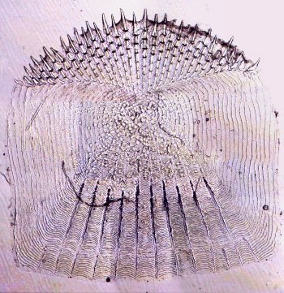
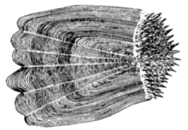
Ctenoid Scales

Slide 3
Ctenoid Scales
Anterior
Posterior

Slide 4
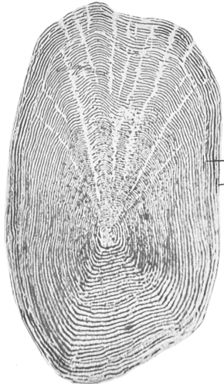
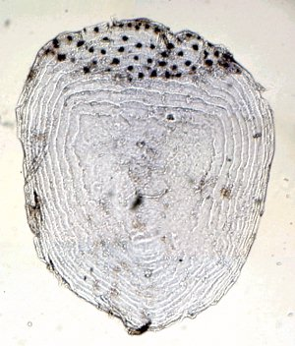
Cycloid Scales

Slide 5
Cycloid Scales
Anterior
Posterior

Slide 6
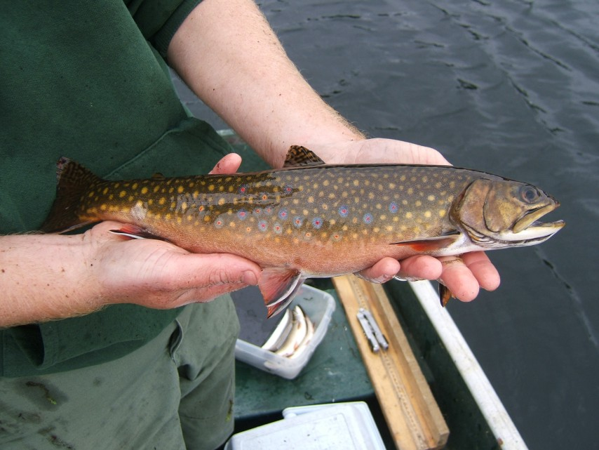
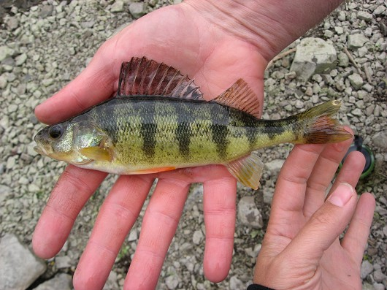
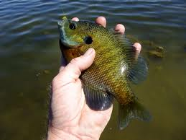
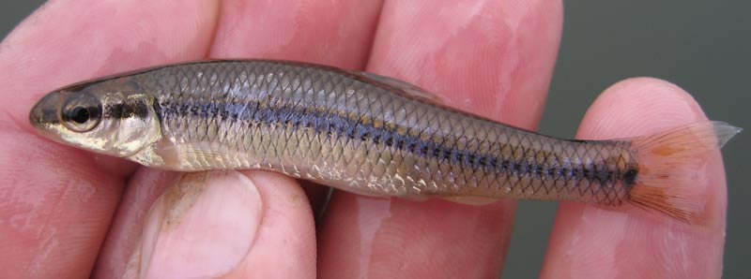
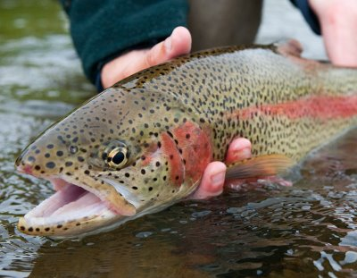
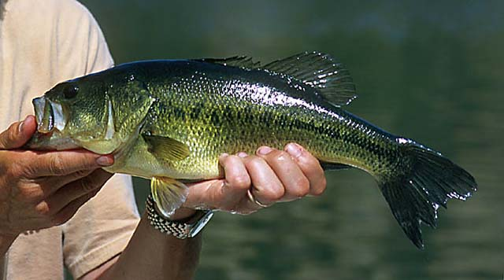
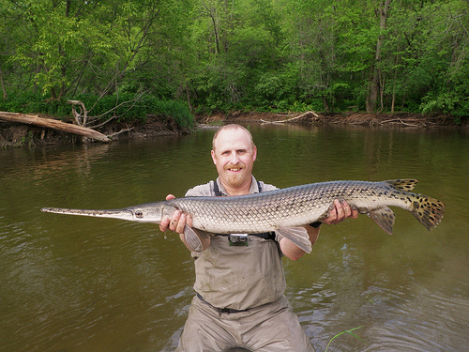
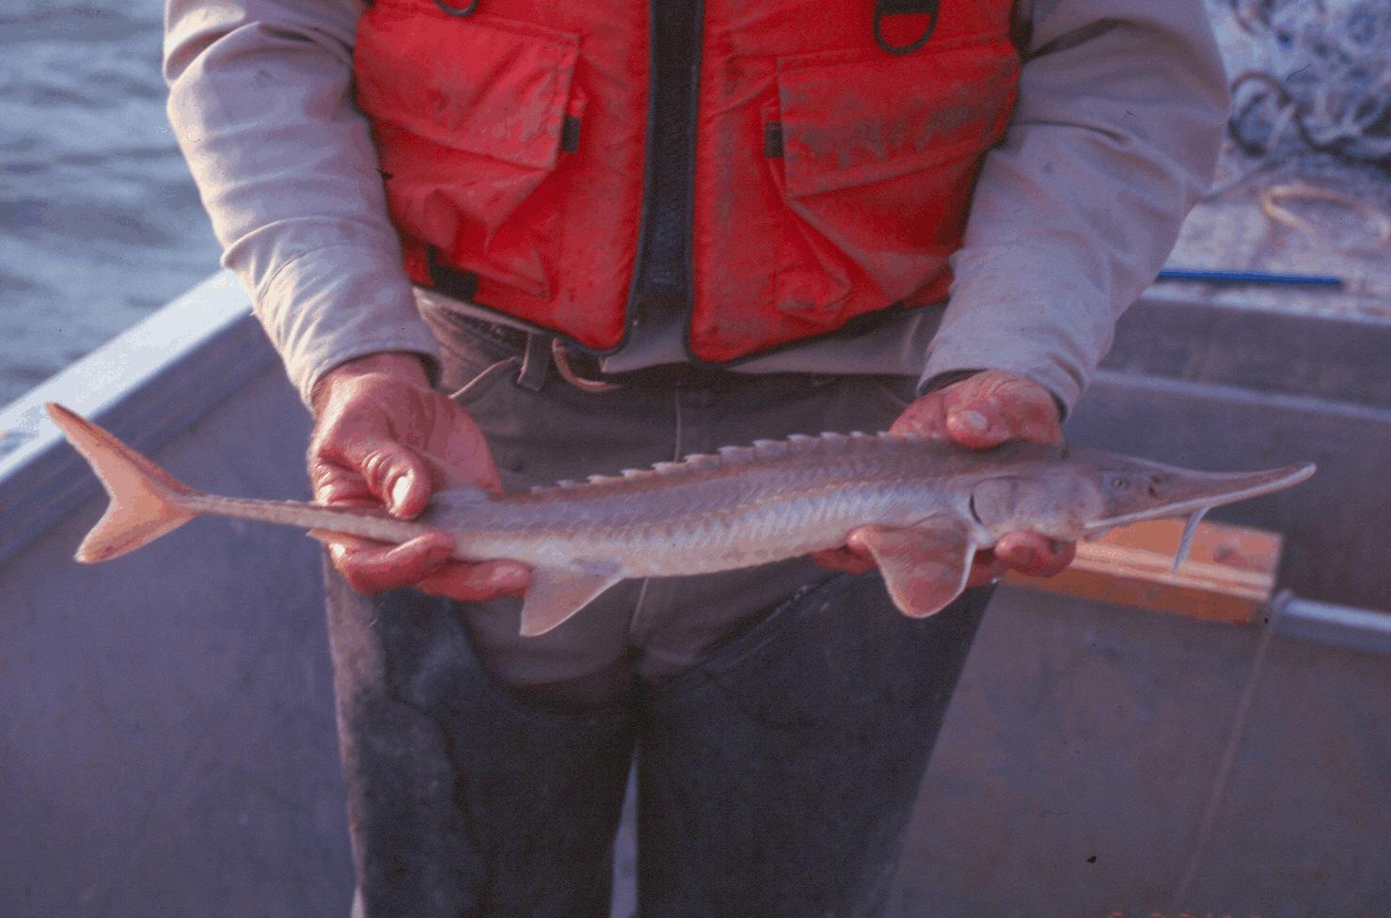
Type of Scale for …
Brook trout
Yellow perch
Bluegill
Bluntnose minnow
Rainbow trout
Largemouth bass
Longnose gar
Shovelnose sturgeon

Slide 7
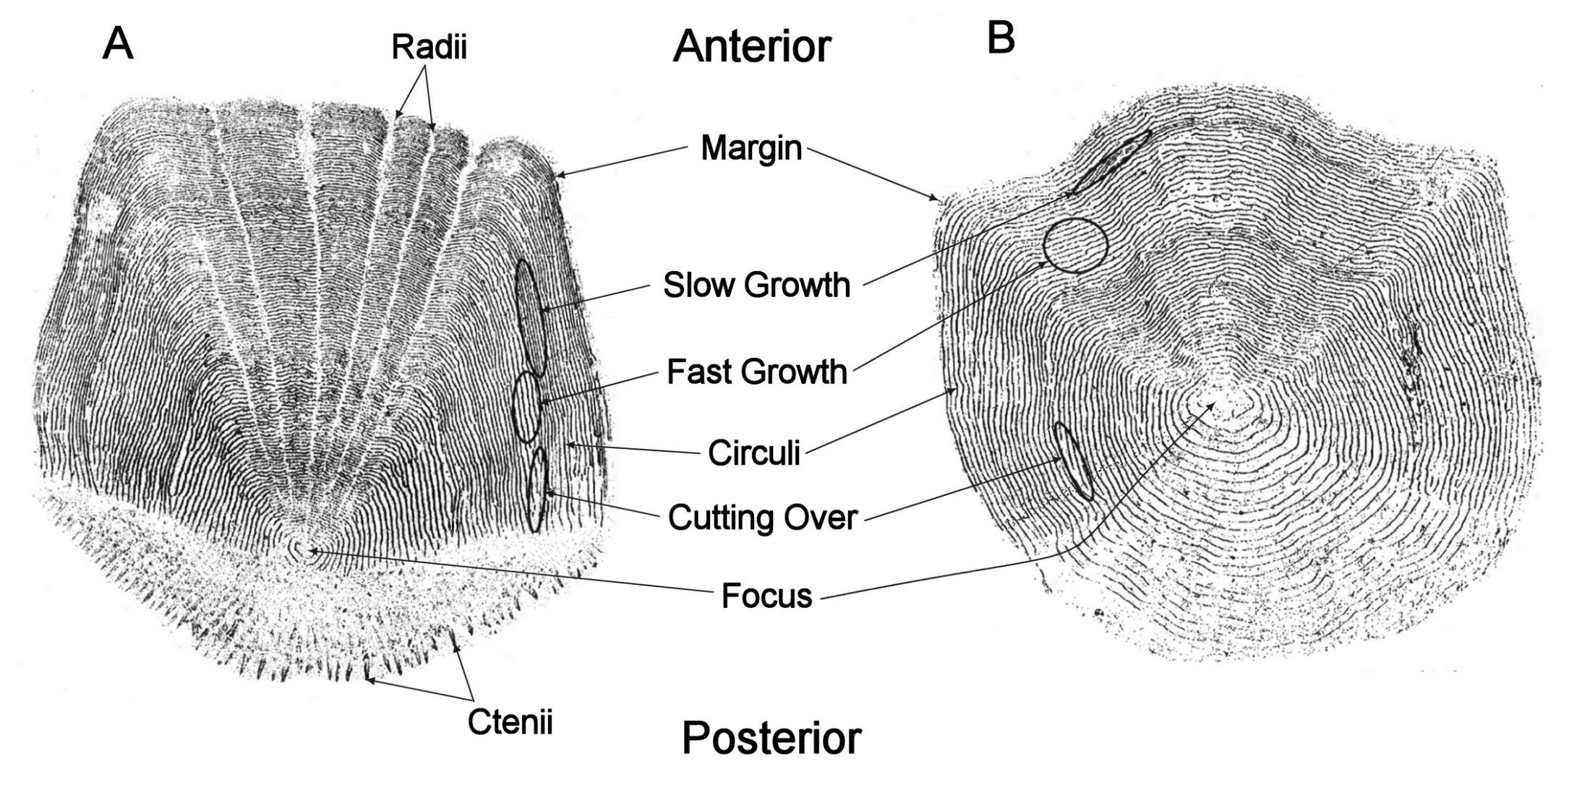
Scale Language

Slide 8
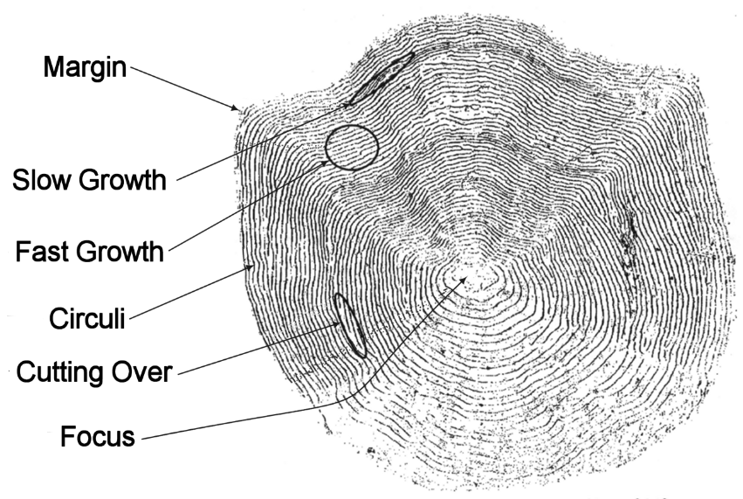
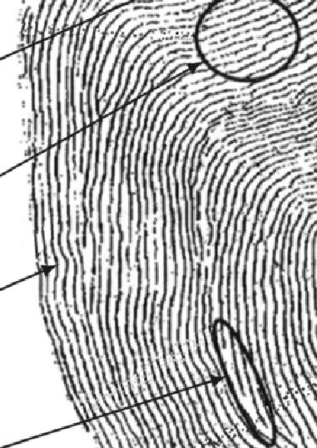
Annulus Characteristics

Slide 9
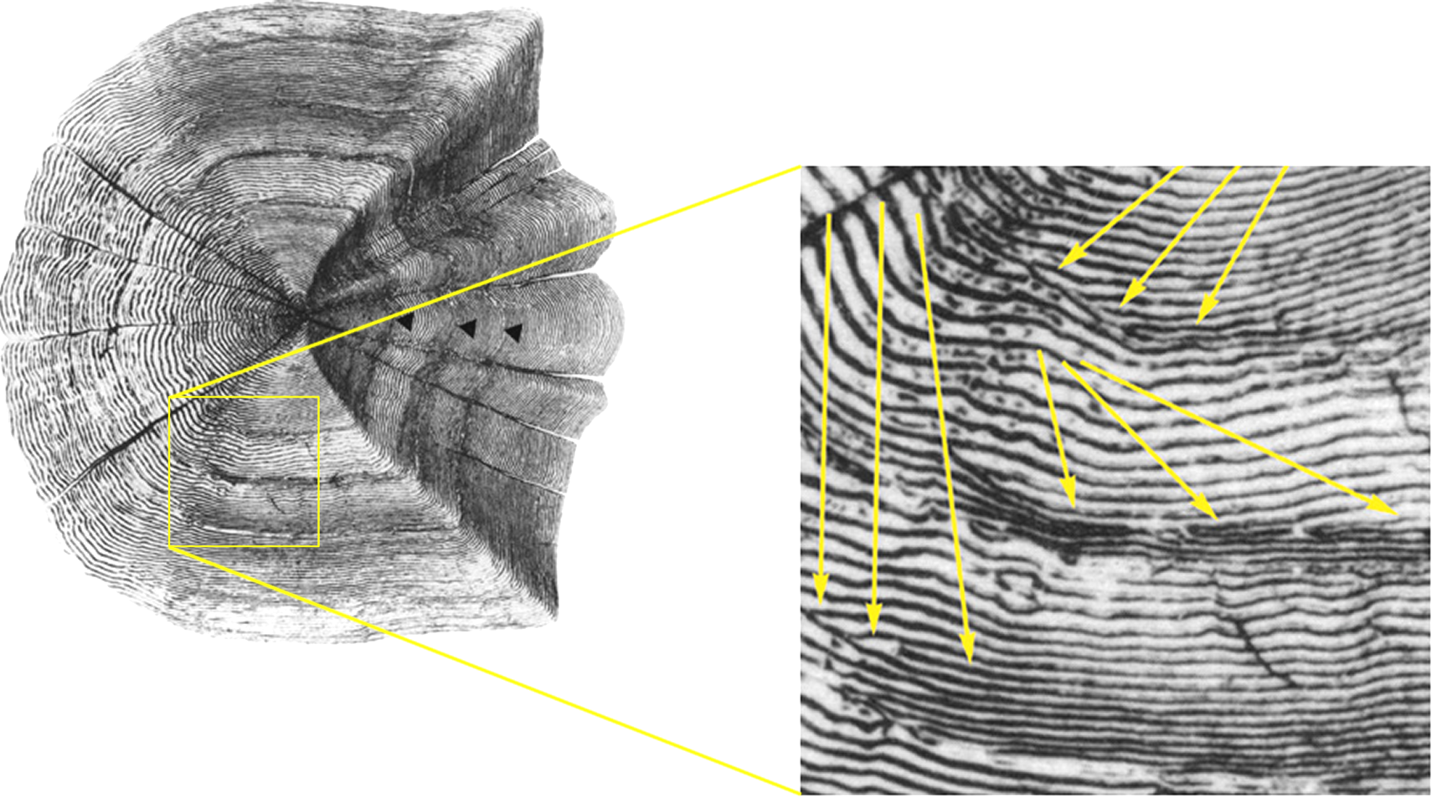
Annulus Characteristics

Slide 10
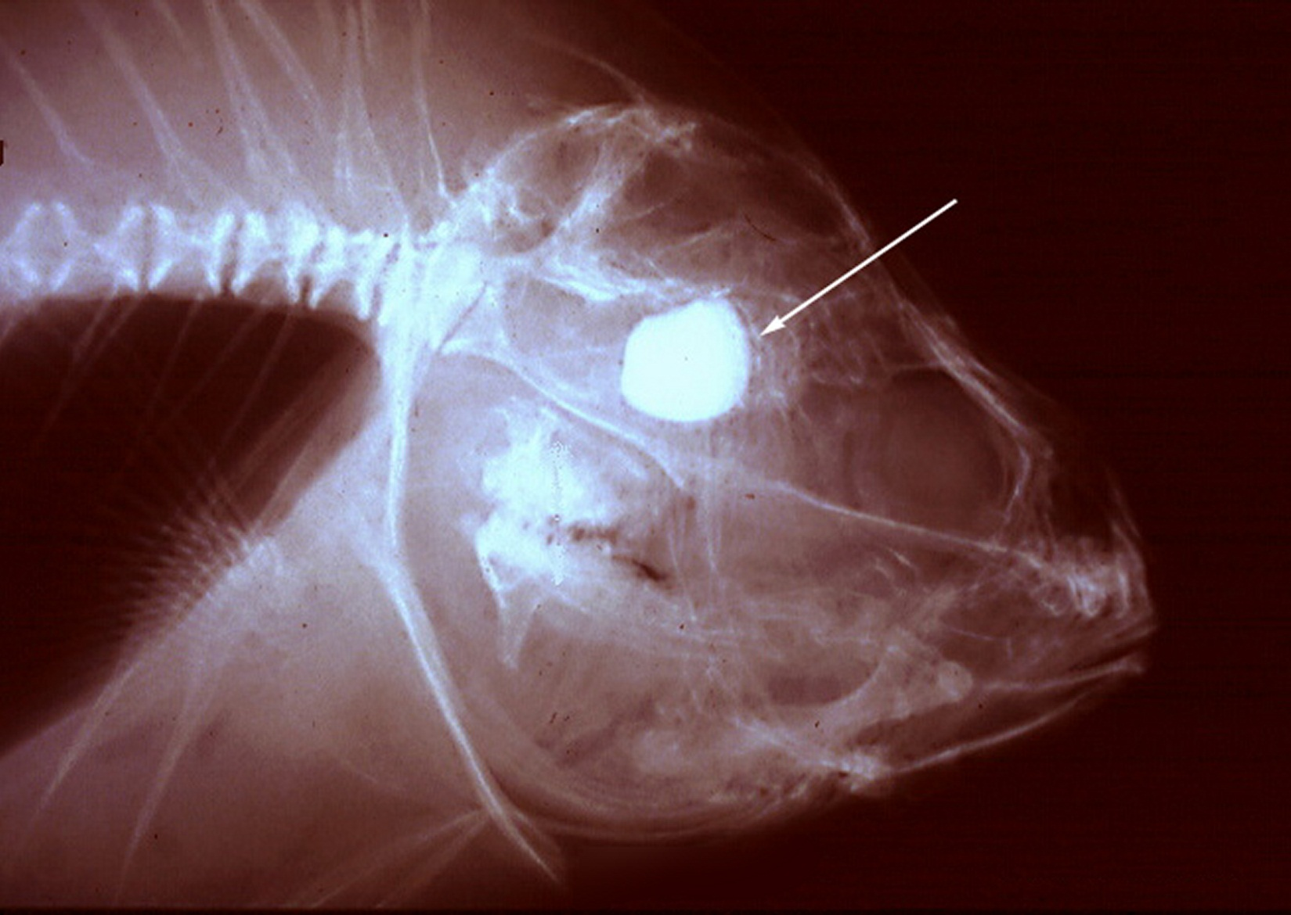
Otoliths
Notes:
Freshwater Drum … from George Spangler

Slide 11
Otolith Extraction

Slide 12
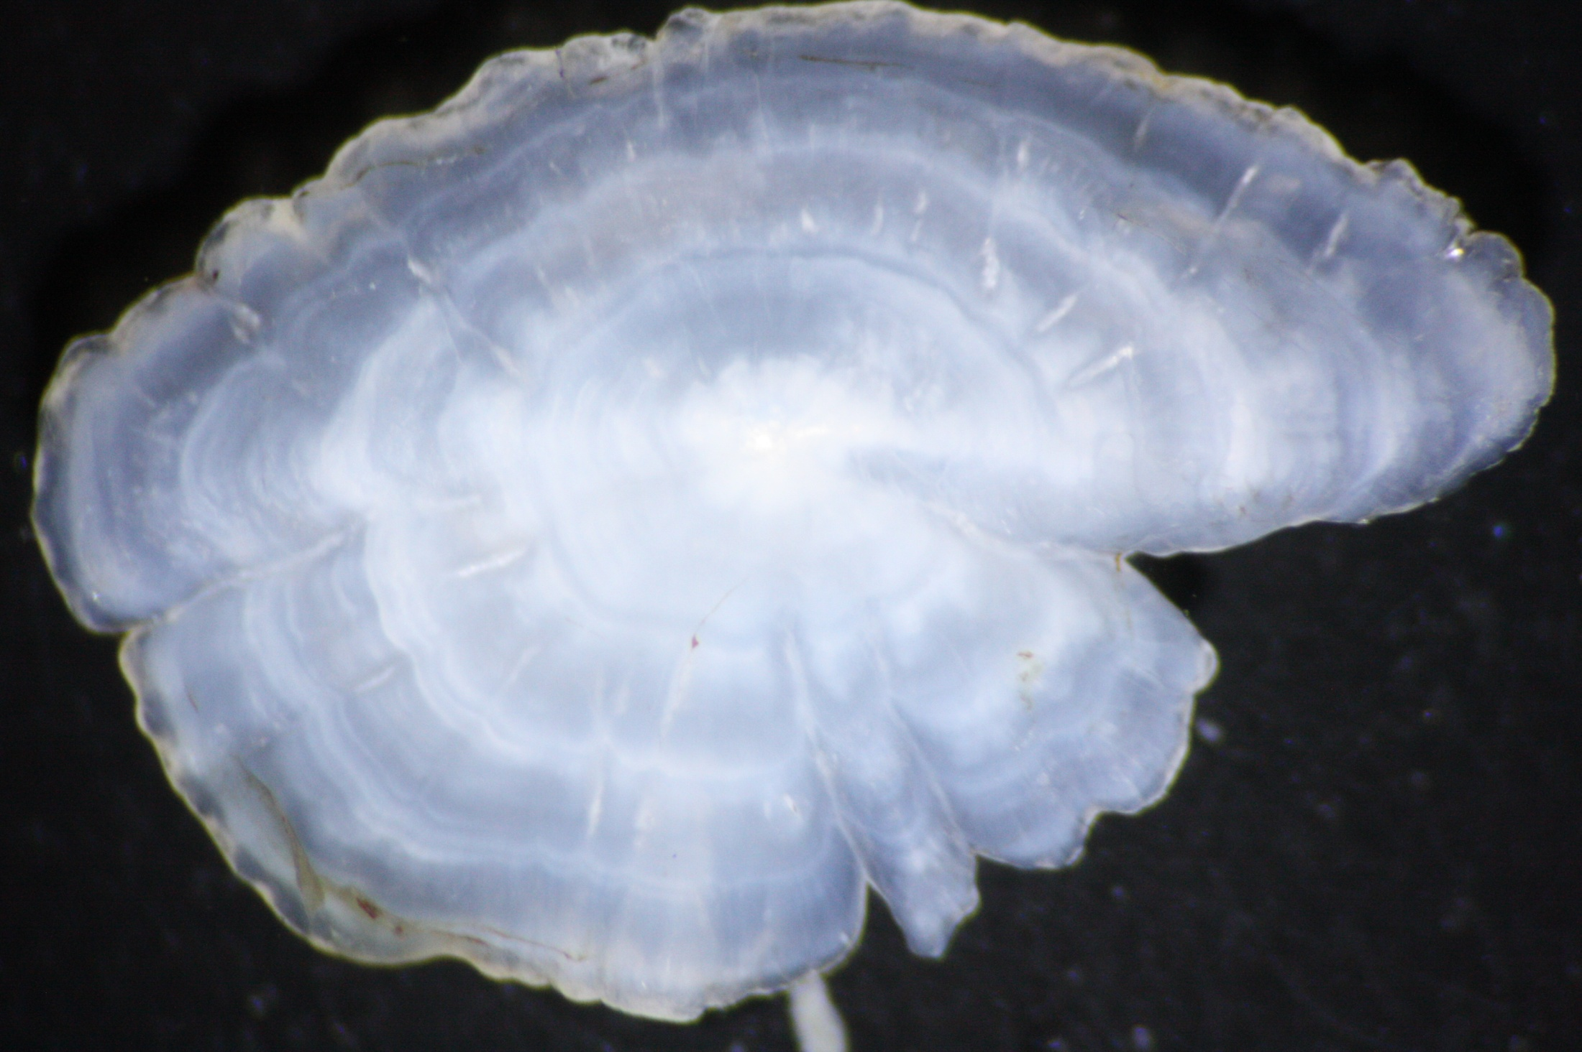
Notes:
Black Crappie whole otolith … from Dan Isermann (UWSP)

Slide 13
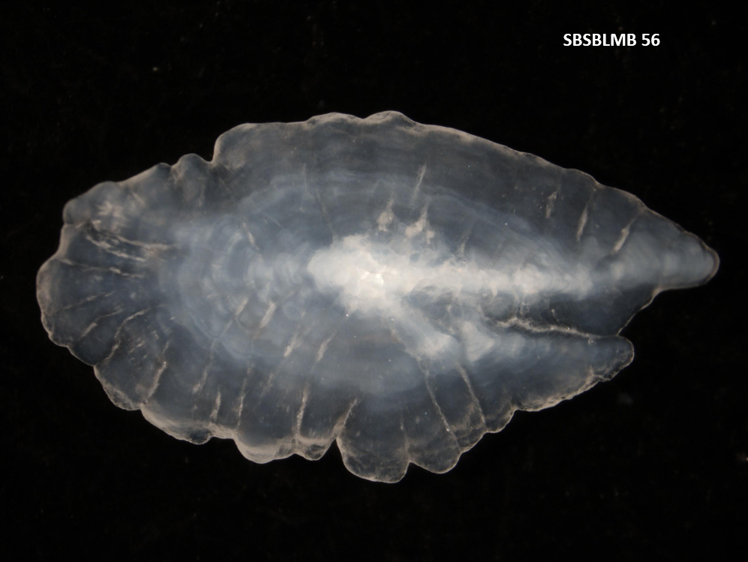
SBSBLMB 56
Notes:
Walleye whole otolith … from Dan Isermann (UWSP)

Slide 14
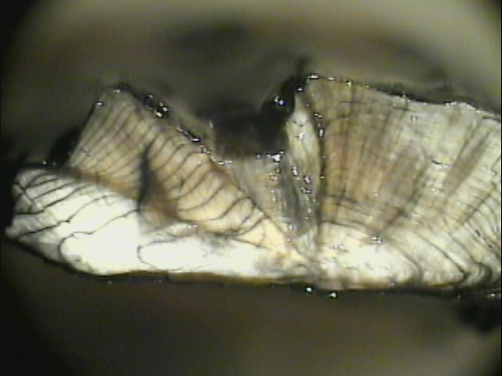
Notes:
Walleye otolith crack-and-burn … from Dan Isermann (UWSP)

Slide 15
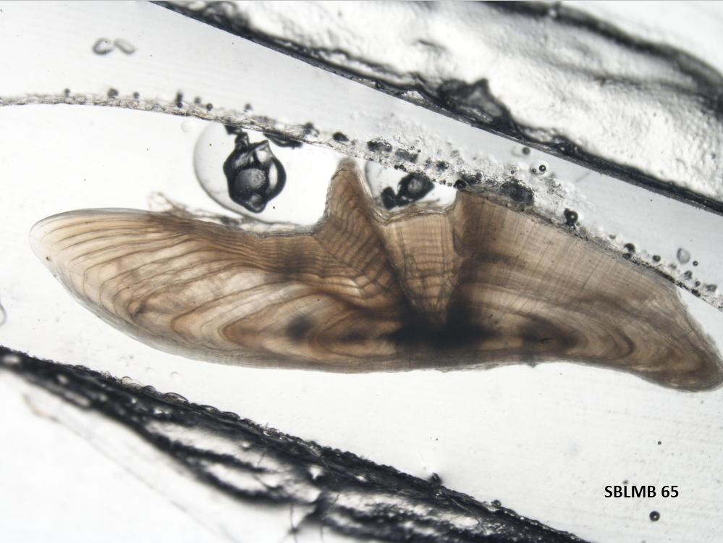
SBSBLMB 56
Notes:
Walleye otolith sction … from Dan Isermann (UWSP)

Slide 16
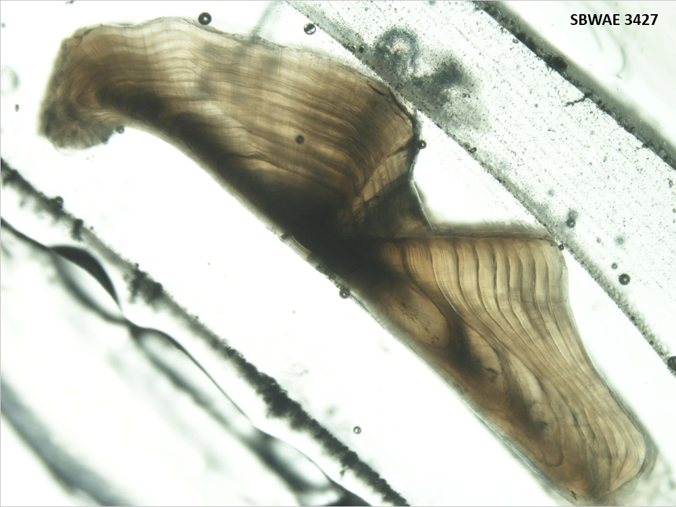
SBSBLMB 56
Notes:
Walleye otolith section … from Dan Isermann (UWSP)

Slide 17
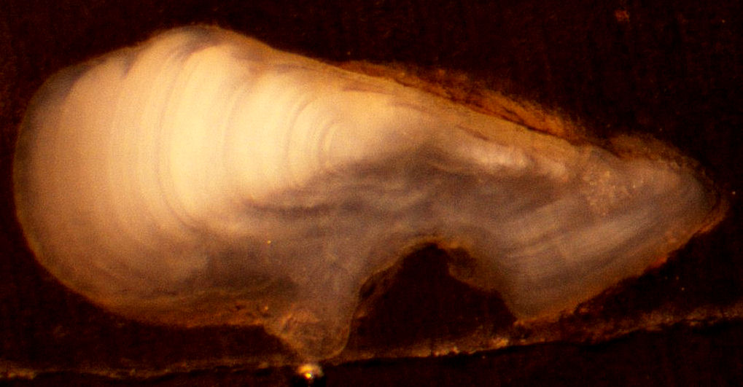
Notes:
Pygmy Whitefish otolith section – from Taylor Stewart

Slide 18
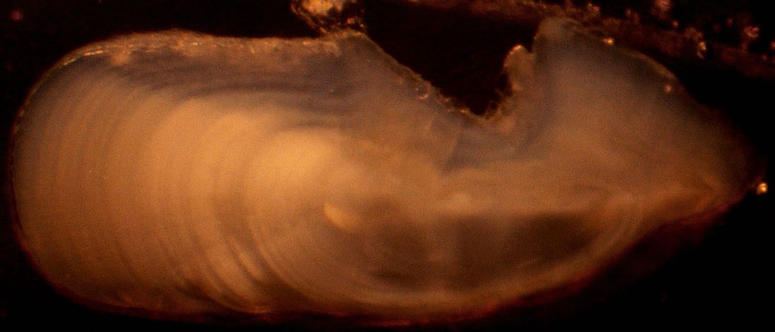
Notes:
Pygmy Whitefish otolith section – from Taylor Stewart

Slide 19
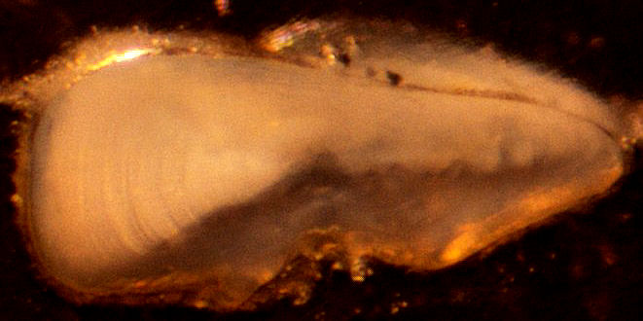
Notes:
Pygmy Whitefish otolith section – from Taylor Stewart

Slide 20
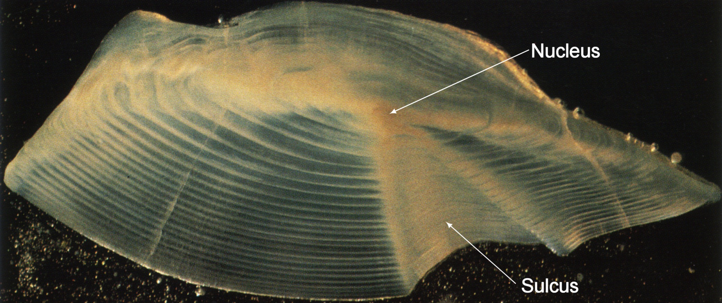
Otolith Language
Annuli
Notes:
Freshwater Drum … from Lyn Bergquist

Slide 21
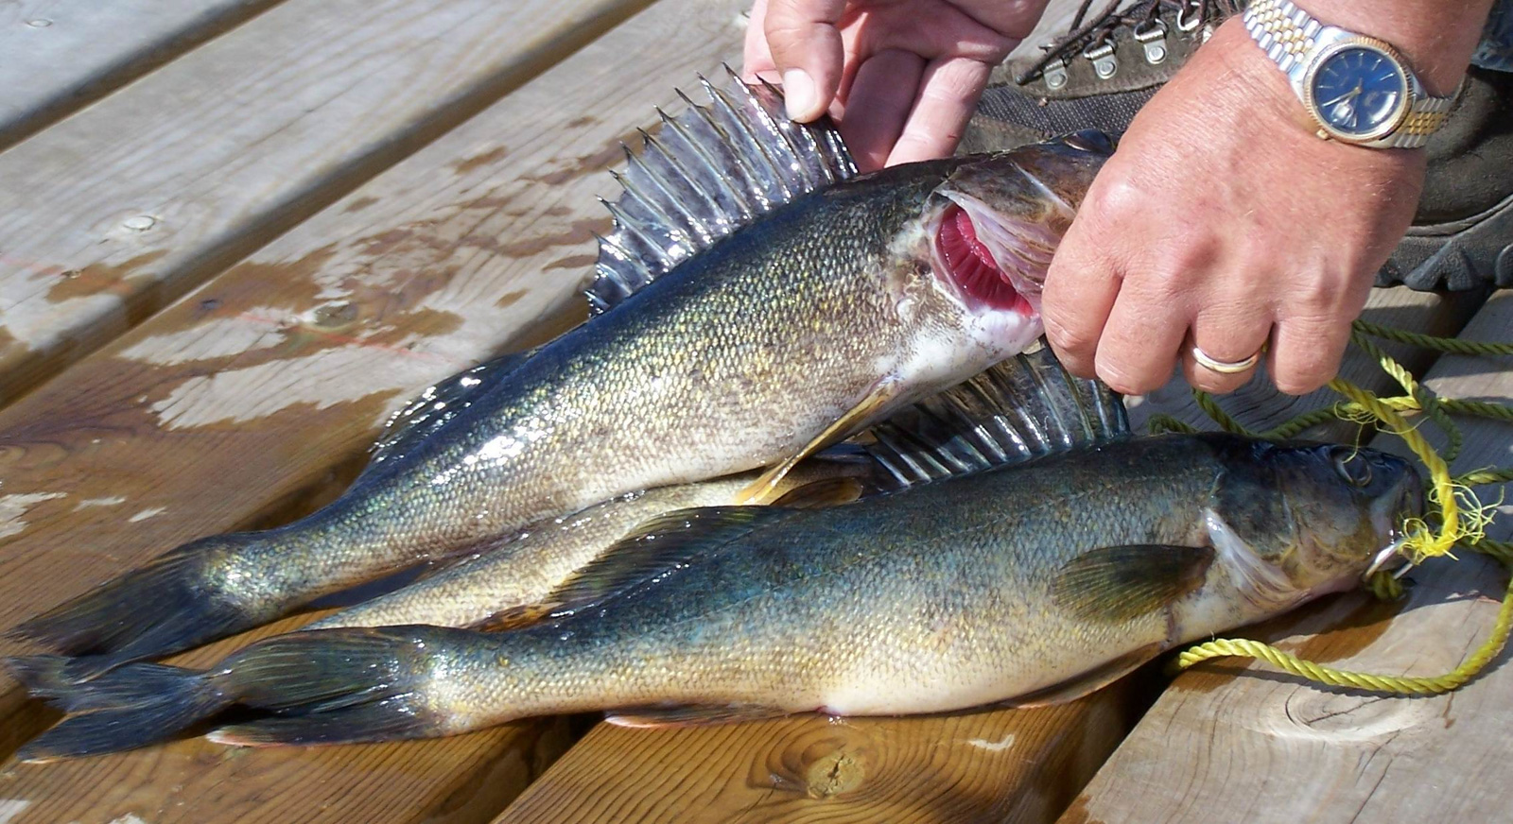
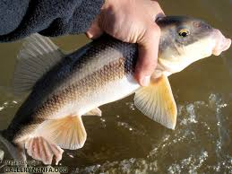
Spines / Fin Rays

Slide 22
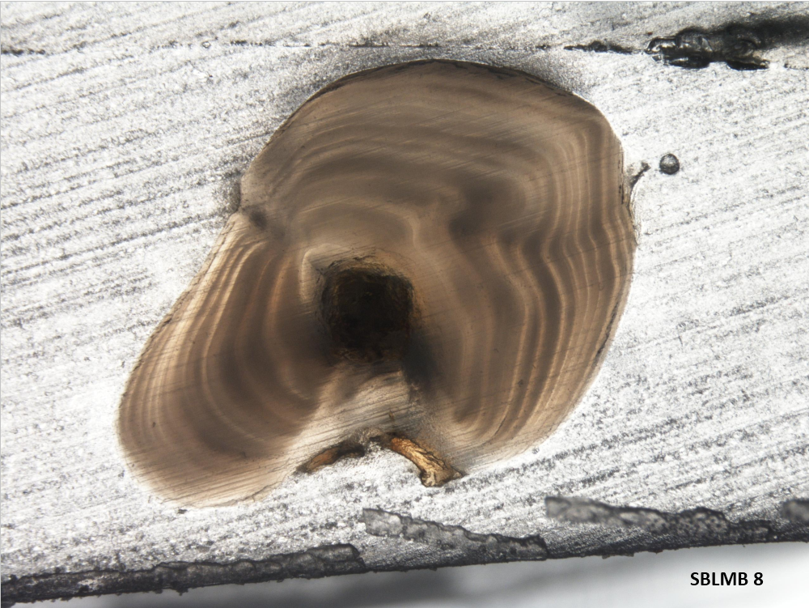
Notes:
Largemouth Bass dorsal spine – from Dan Isermann (UWSP)

Slide 23
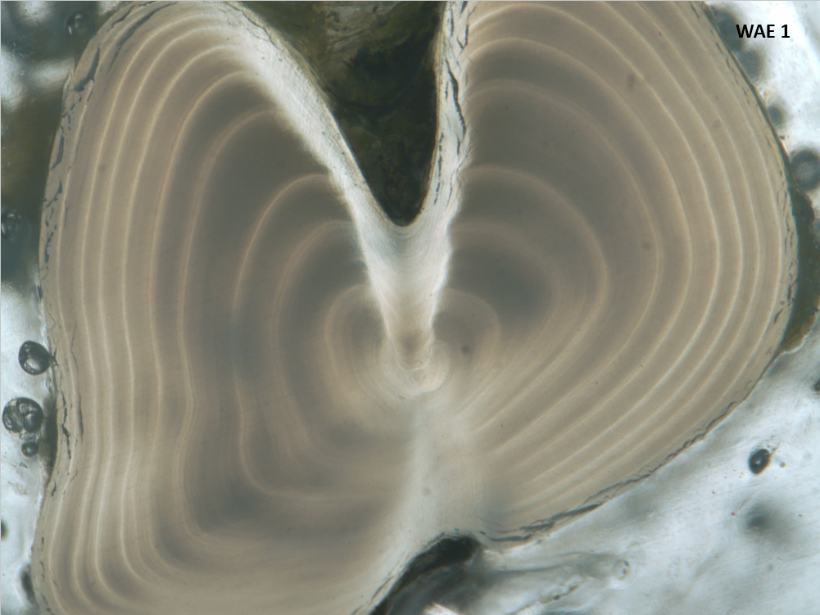
Notes:
Walleye dorsal spine – from Dan Isermann (UWSP)

Slide 24
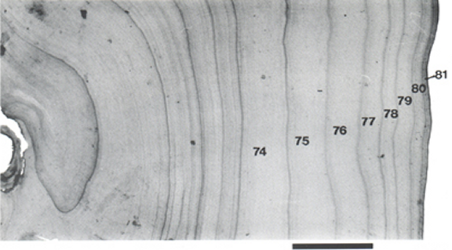

Slide 25
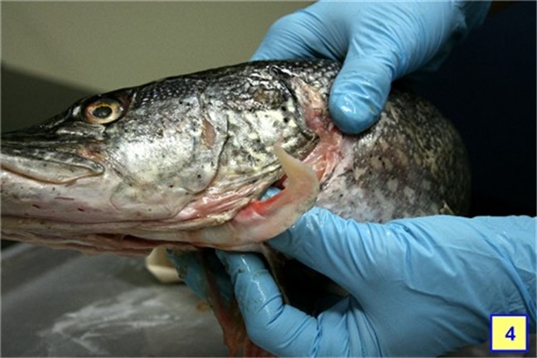
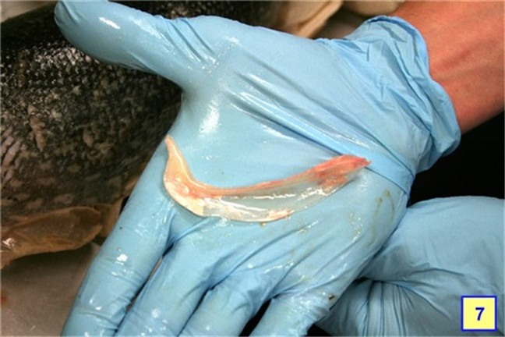
Cleithrum

Slide 26
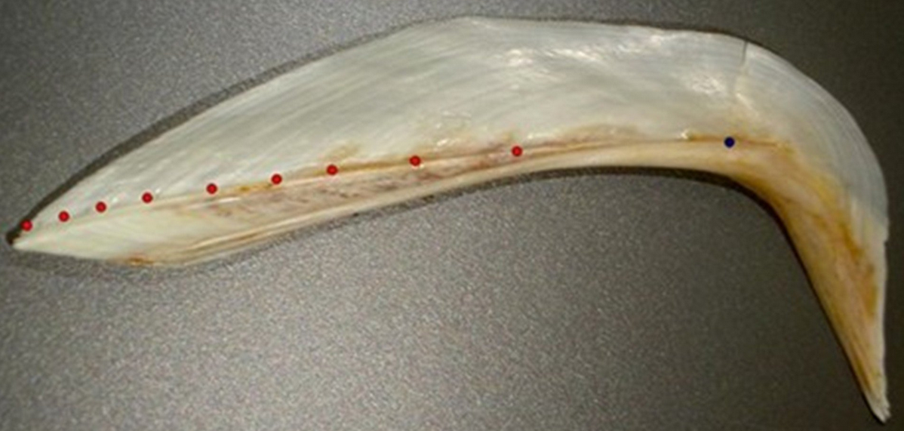

Slide 27
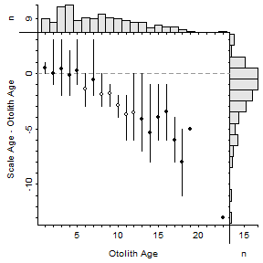
Structure Comparisons
Notes:
Lake Champlain Lake Whitefish

Slide 28
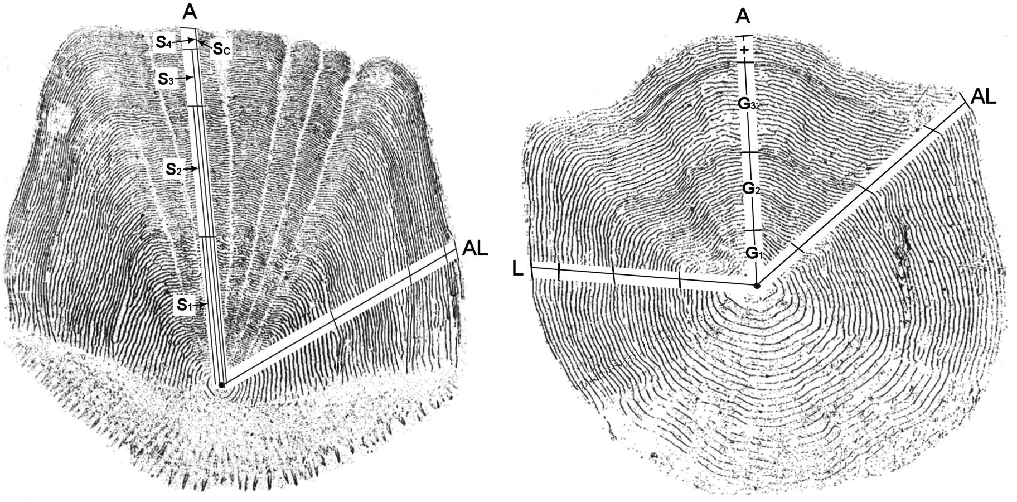
Back-Calculation
Estimate previous fish length from scale size
IDEA – proportional growth on scale equals proportional growth of fish
i.e., if S₁ is 30% of S_{c} then L₁ is 30% of L_{c}

